Slide 1

Presentation Night 2026
WESTERN SUBURBS DISTRICT HOCKEY CLUB

Slide 2


Agenda
Welcome
Year in Review
Trophies
  Most Goals Scored
  Best and Fairest
  Guts and Determination
  Most Improved
Captain's Award
Manager's Awards
President’s Awards
Special Thanks

Slide 3
Welcome
Ric Byrnes
Mary Hennessy
Craig Meller

Slide 4

Special thanks
Dennis Burgess, Chairman
&
Clare Burgess

Slide 5

Special thanks
Grant Bentley, Owner
&
Richelle Bentley

Slide 6
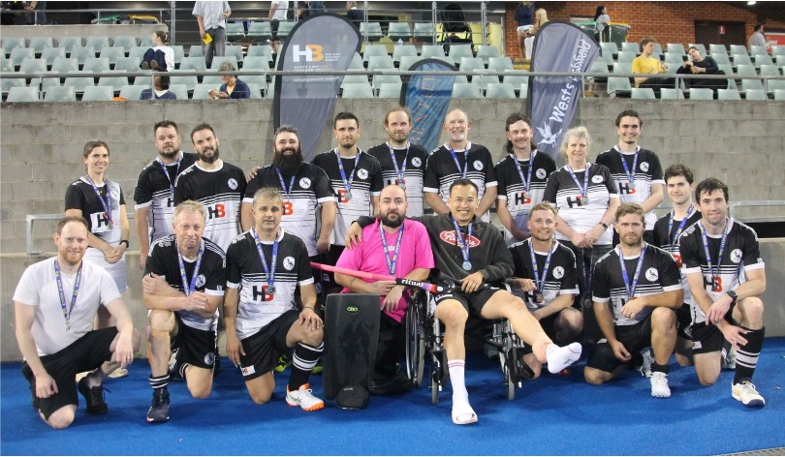
Men’s SL4
2026
Minor premiers
and
Grand final Runners Up

Slide 7
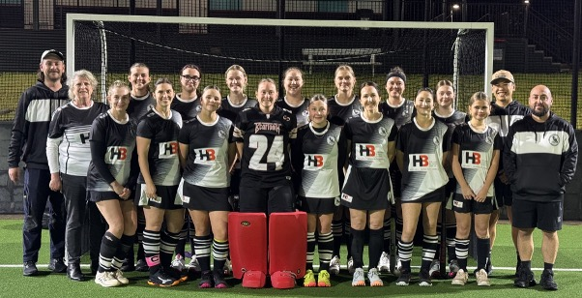
Women’s 1st Grade
2026 Season
6^{th place}

Slide 8
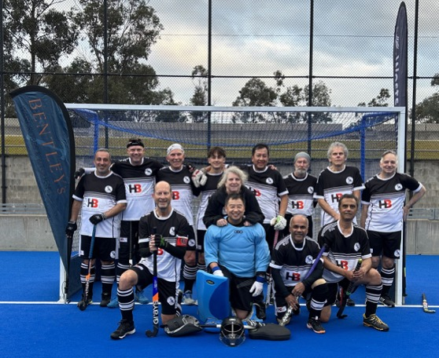
Men’s SL7
2026 Season
7^{th place}

Slide 9
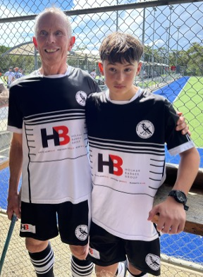
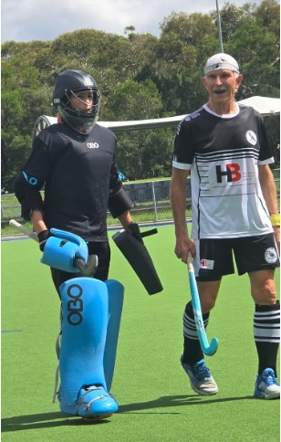
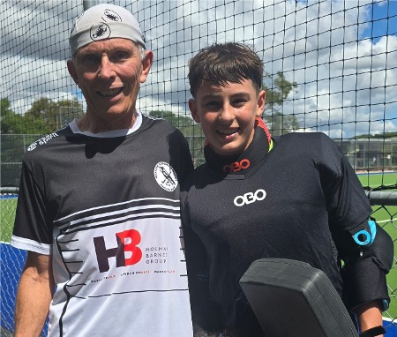
Wests Family Time 2026

Slide 10
VideoS
Wests Men’s SL4
Wests Women’s W1
Wests Men’s Sl7

Slide 11

Life Members
D. Chillmaid
K. Clifton
V. Dang
I. Eagleson
K. Gardner
J. Hailstone
G. McKay
F. Polodorus
J. Punch
J. Robinson
D. Russell
G. Stidwell
P. Stokes
A. Torr

Slide 12

Trophies
  Most Goals Scored
  Best and Fairest
  Guts and Determination
  Most Improved

Slide 13
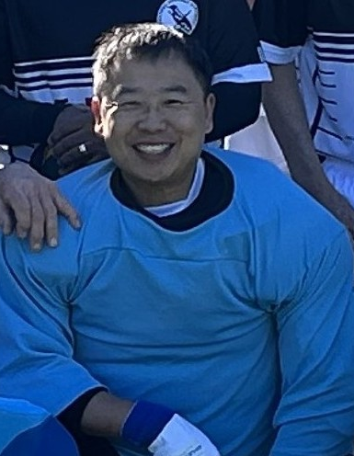
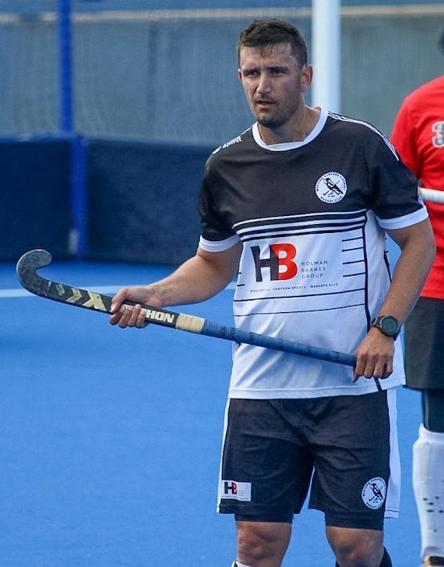
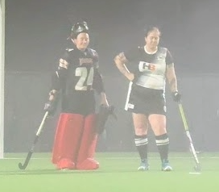
Frank Polidoros Memorial Trophy for Best and Fairest
  Women’s 1st Grade
  Men’s SL7
  Men’s SL4
  Lara Campbell
  Peter Yick
  Terrence Bowden

Slide 14
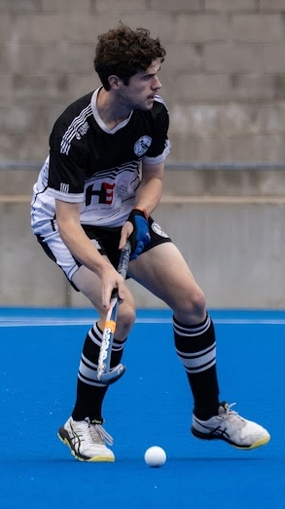
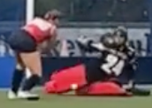
John Punch Memorial Trophy for Guts and Determination
  Women’s 1st Grade
  Men’s SL7
  Men’s SL4
  Lara Campbell
  Peter Yick
  Timothy Hurley

Slide 15
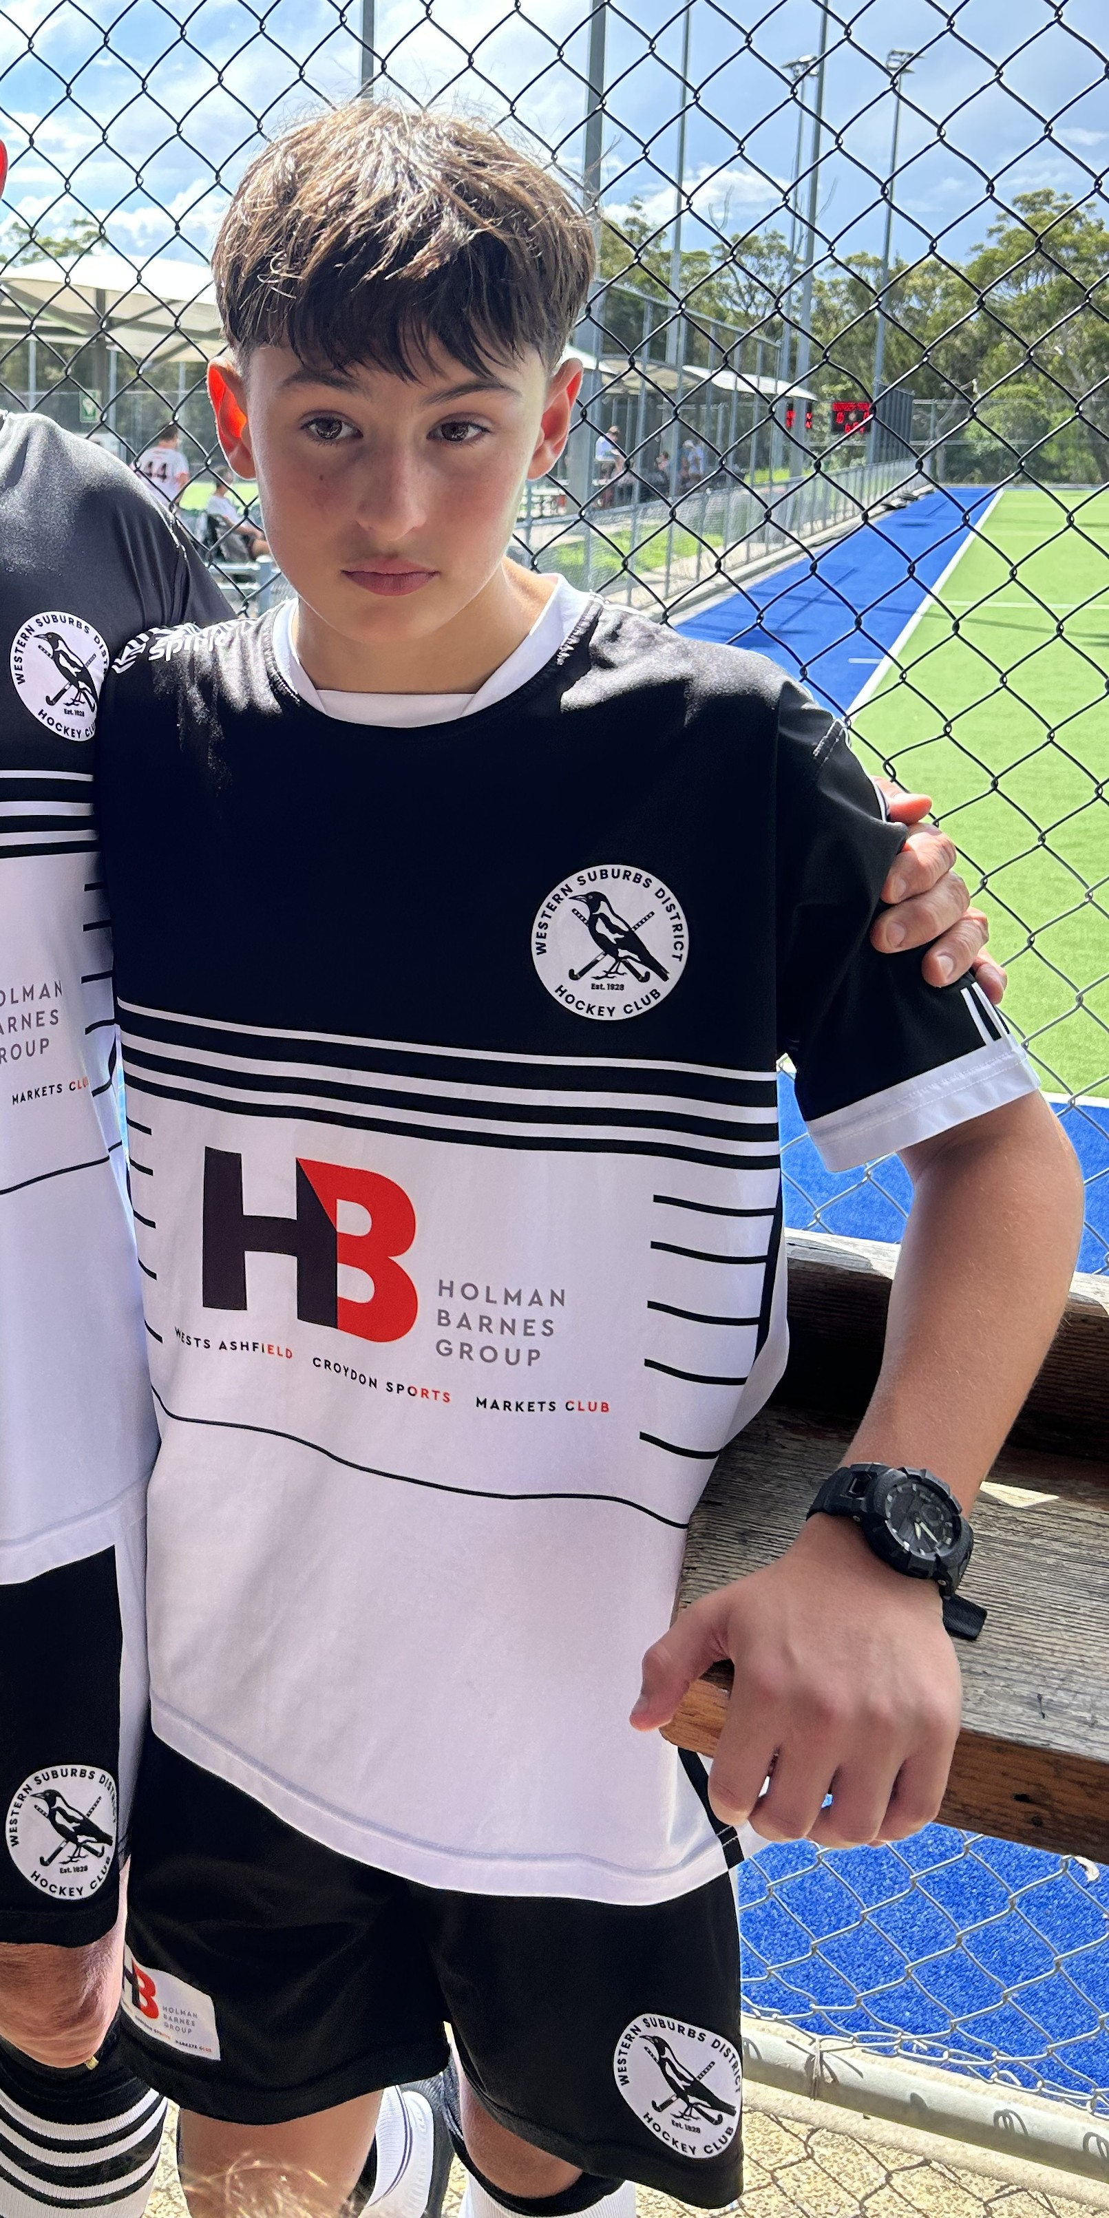
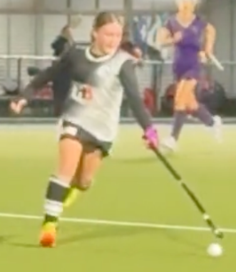
Ken gardner Memorial Trophy for Most Improved
  Women’s 1st Grade
  Men’s SL4
  Men’s SL7
  Alice Newell
  Timothy Hurley
  Cooper Humphreys

Slide 16
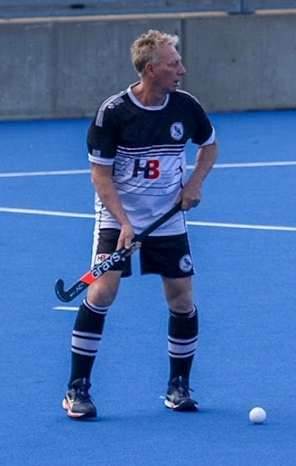
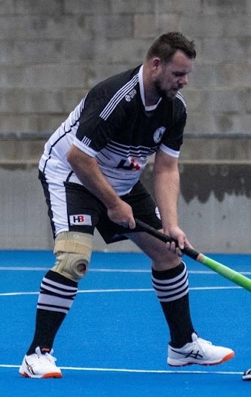
CAPTAIN’s Award
Captain Men’s SL4: Jacob Beatty
Darren Pearce
Paulo Keliele

Slide 17

CAPTAIN’s Award
Captain Women’s 1st Grade: Yvie Dunn
Kim Sagar
Kim was crucial to the team this year. She only missed one game and it was by far the hardest game we played.
I play in her position for the game she missed and gained a whole new appreciation for everything she does.
She not only mentored and guided younger players, set up our structure, and kept the chat constant, she also plays her hardest while staying calm, and is genuinely always happy to be out there, every single game. Kim, thank you for moving us forward this year, please don't ever miss a game again.

Slide 18
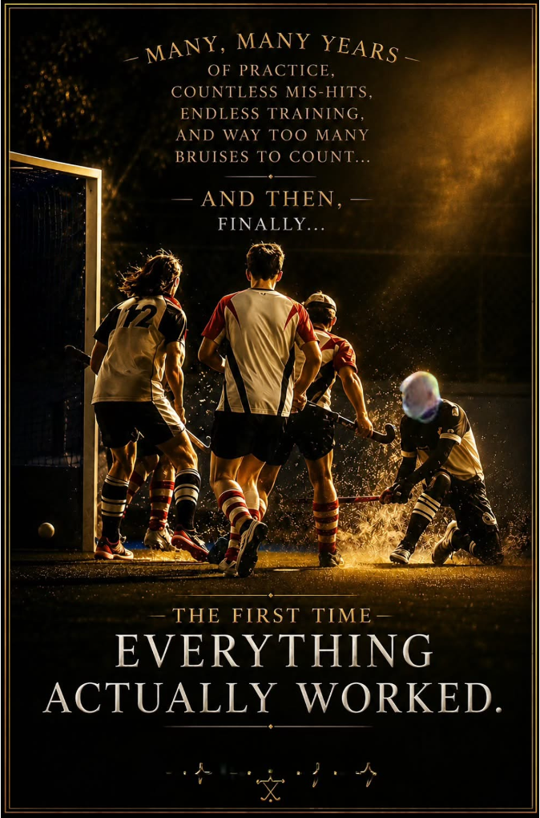
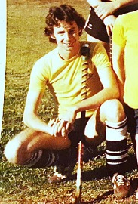
CAPTAIN’s Award
Captain Men’s SL7: Craig Meller
Tomahawk King - Brian Jones

Slide 19
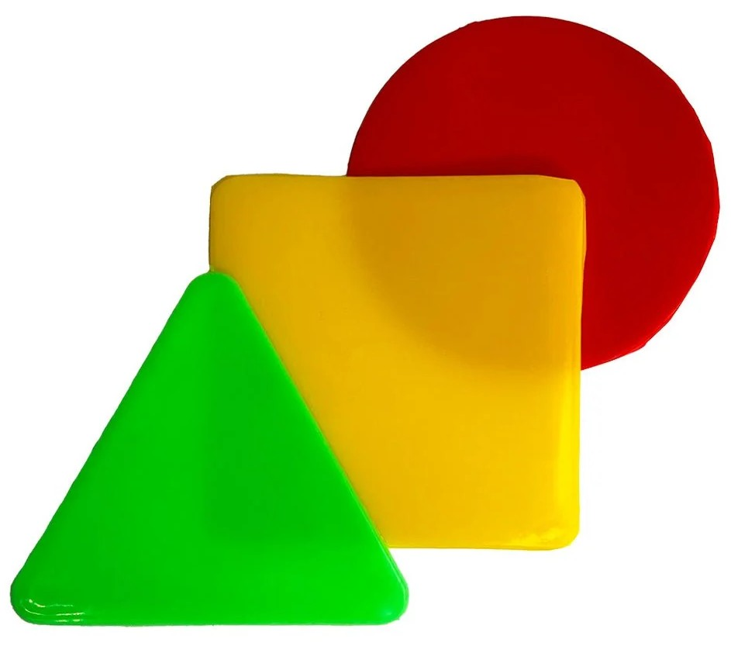
Managers Award
Mary Hennessy

Slide 20

President’s Awards
Ric Byrnes

Slide 21
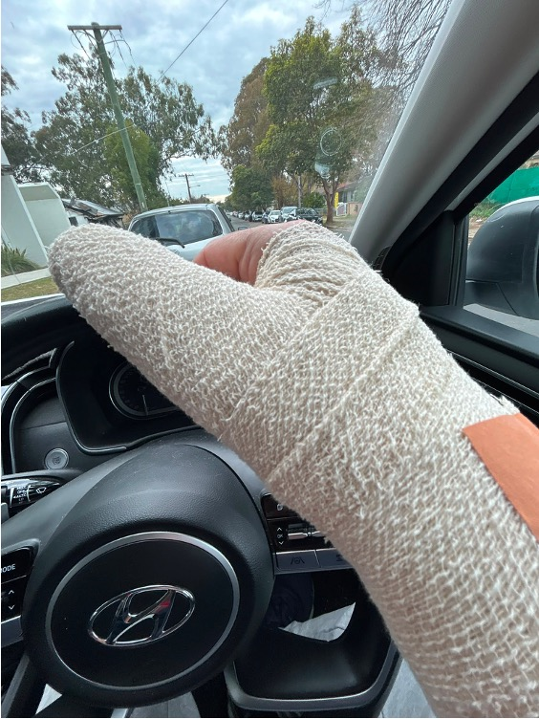

Breaking his thumb in a game – But wait…
Mr Clumsy Bump
Nominee - Mark Bruhn
Didn’t he have a thumb injury last year???

Slide 22
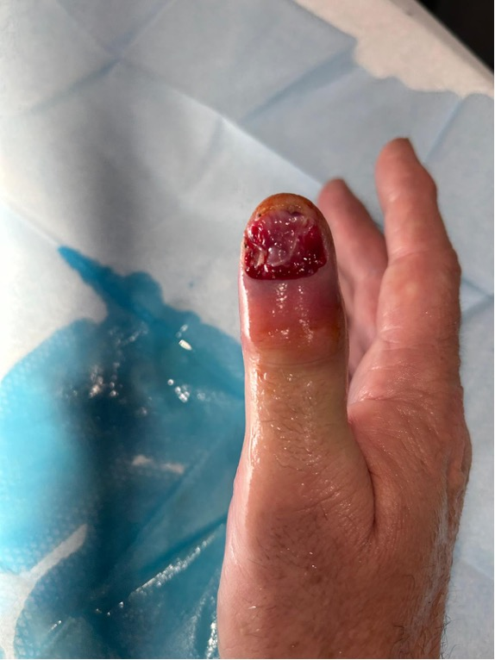
Mr Clumsy Bump
Nominee - Mark Bruhn
Yep – Last year’s injury.
…Was this just Mark taking full advantage of Medicare now he’s an Australian Citizen??

Slide 23
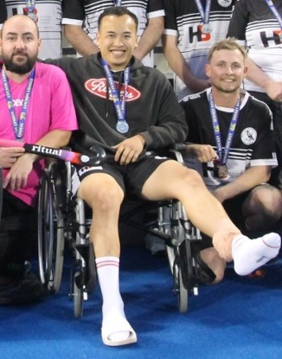
Mr Clumsy Bump
Nominee – Michael Tran
Maybe he just wanted to give everyone a chance to catch up on goals…
Nope, he waited until the last game to rupture Achilles!

Slide 24
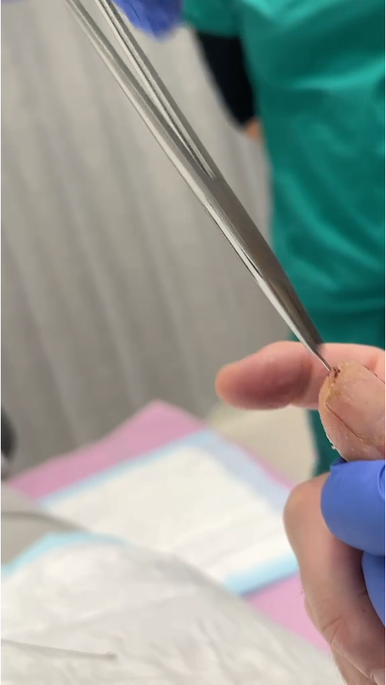


Mr Clumsy Bump
Winner - Mark Bruhn
Awarded Emergency Hand Injury Kit - Thumb Splint, Sling and pack of Skewers… Just in case!
Yep confirmed. Mark Is taking full advantage of Medicare now he’s an Australian Citizen!

Slide 25

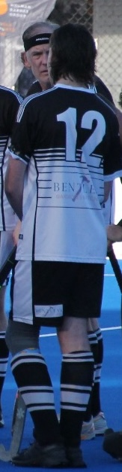
Best Bandana Or HEadband
Nominees
SL7
  Brian Jones
  Jeff Humphreys
  Matt Smith
Erin Giarrantano
Jacob Beatty

Slide 26
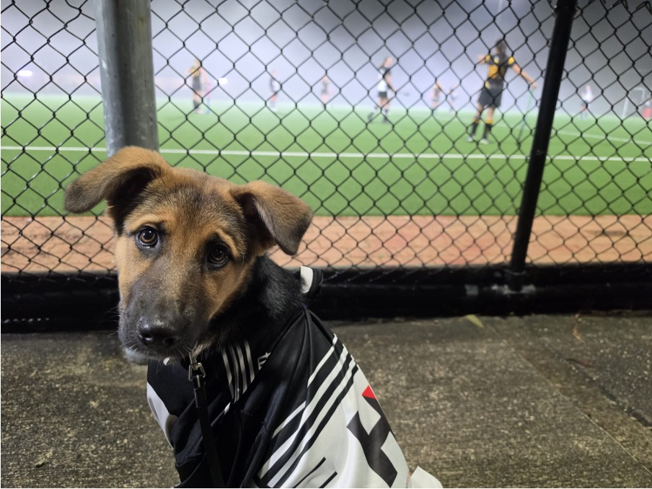
Best Bandana Or HEadband
Winner - Echo

Slide 27
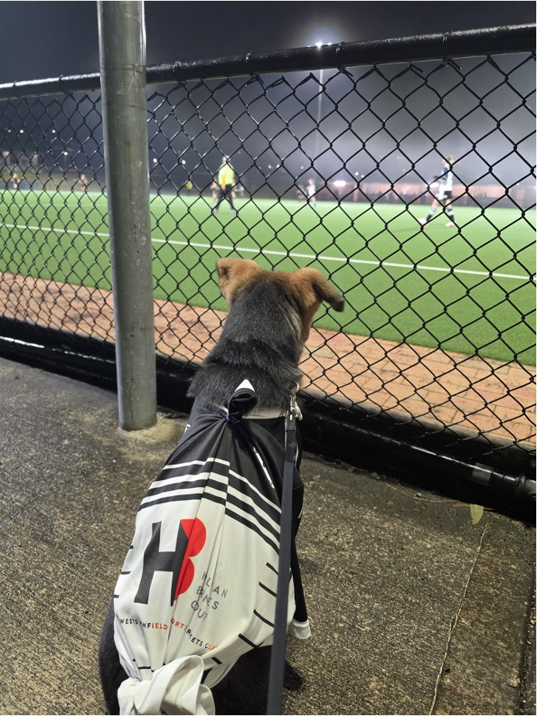
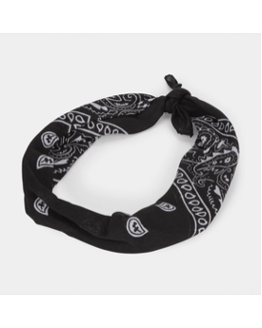

Best Bandana Or HEadband
Winner - Echo
Awarded Black and white Game Bandanas and some treats to enjoy while watching the game.
Stop bothering me I’m watching the game!

Slide 28
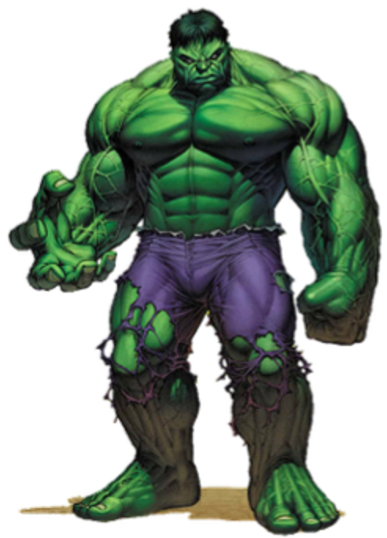
MR Angry

Slide 29


MR MRS Angry
Winner – Mary Hennessy
Awarded Hulk Plushy!
Don’t get her angry… A picture tells a thousand words…
Why??

Slide 30
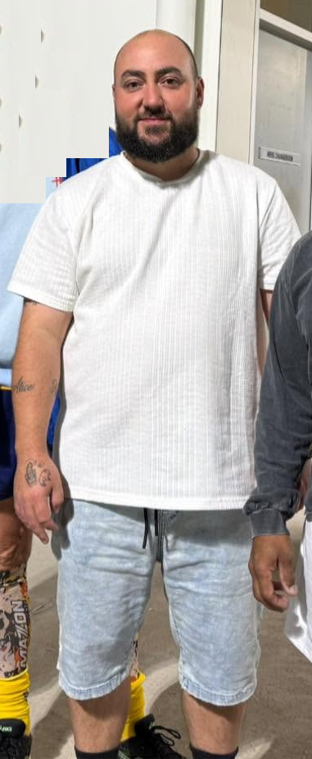
President’s Award – Club Person of the Year
Winner – Josh Newell
Always Going above what is asked…

Slide 31
Special thanks
Audra Barclay – SL7 Photographer, Media
Archie Bowden – SL4 Media and Equipment
Yvie Dunn
  W1 Captain
  SL4 Coach
Mary Hennessy
  SL4, SL7, W1 Team Manager
  Club Secretary
James Mills-Hicks – Social Media (Committee Member)
Brian Jones – Equipment (Committee Member)
Alice Newell – SL4 Media and Equipment
Josh Newell – W1 Coach
Les Simpson - Umpire
Michael Tran – W1 coach
As a thank you, the recipients received gifts.

Slide 32


Thank You

