Slide 1

Presentation Night 2025
WESTERN SUBURBS DISTRICT HOCKEY CLUB

Slide 2

Agenda
Welcome
Year in Review
Life Member
Trophies
  Most Goals Scored
  Best and Fairest
  Guts and Determination
  Most Improved
Captain's Award
Manager's Awards
President’s Awards
Special Thanks

Slide 3
Welcome
Ric Byrnes
Mary Hennessy

Slide 4

Special thanks
Curt Pahl

Slide 5

Special thanks
Grant Bentley

Slide 6
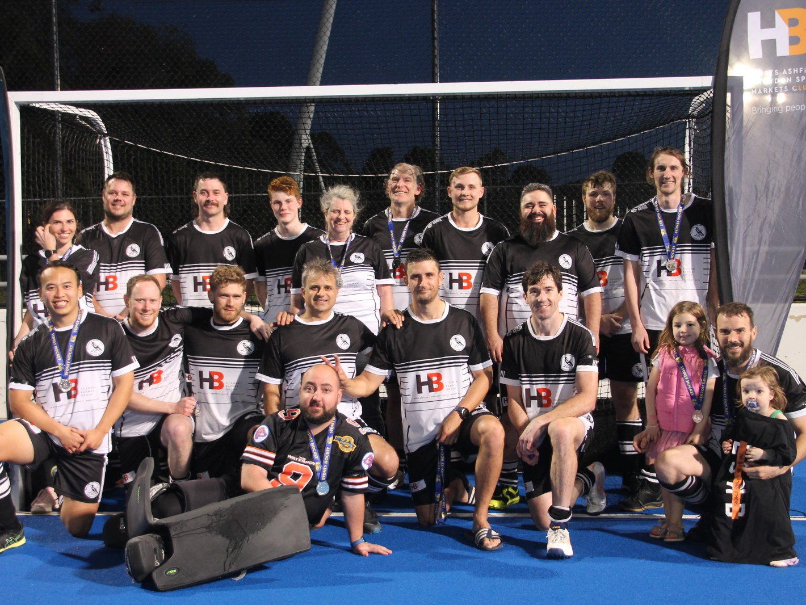
SL5
2025
Runners Up

Slide 7
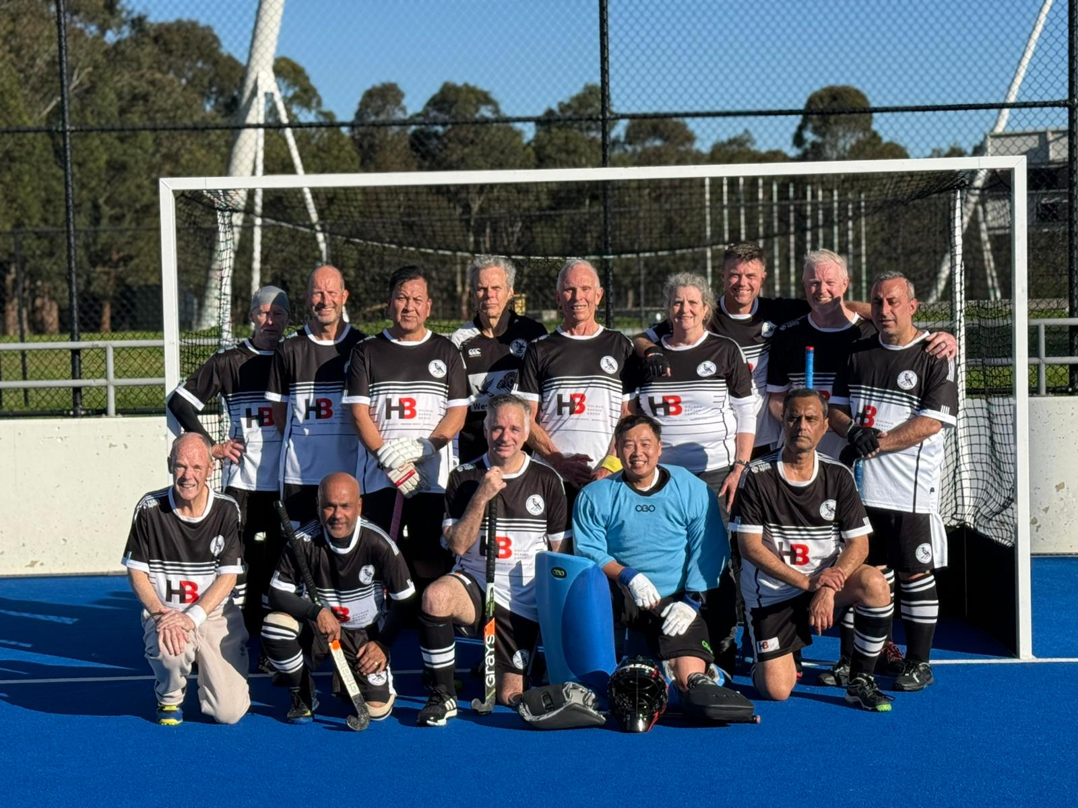
SL7
2025 Finalists

Slide 8
VideoS
Wests SL7
Wests SL5

Slide 9
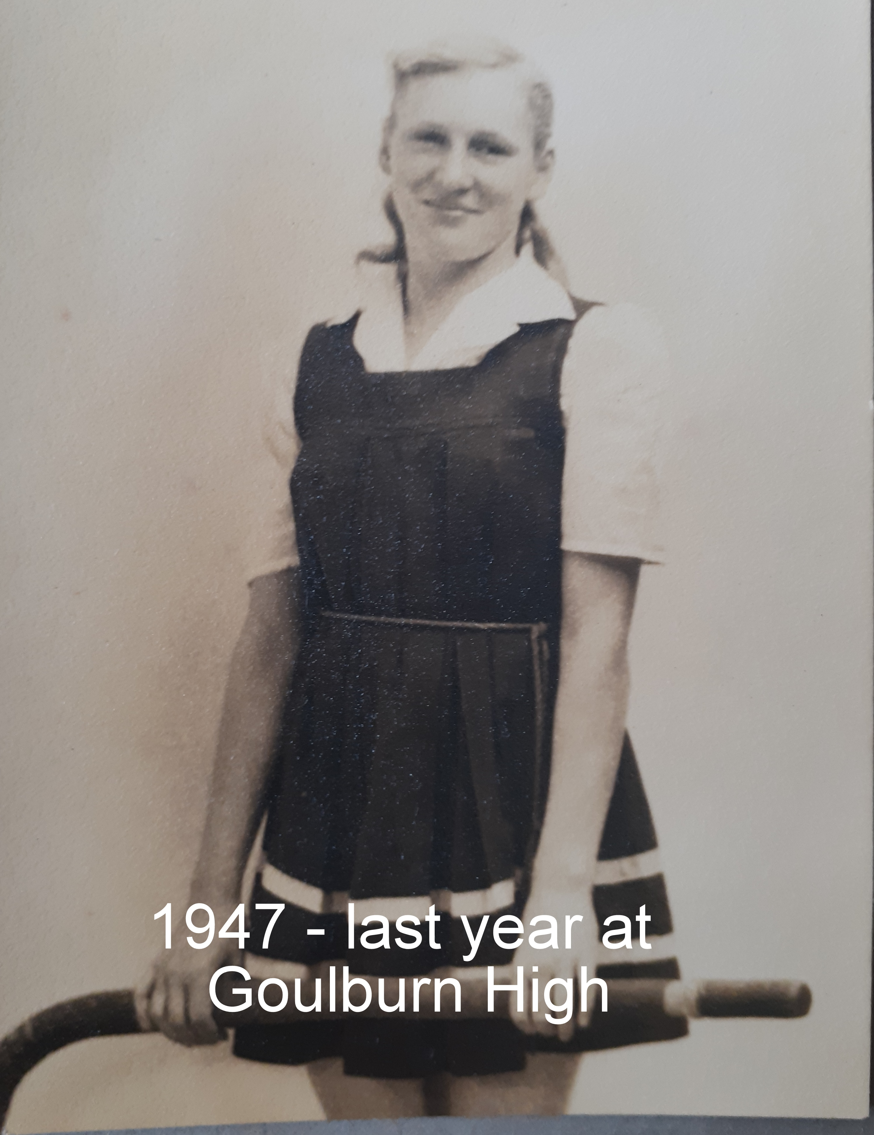
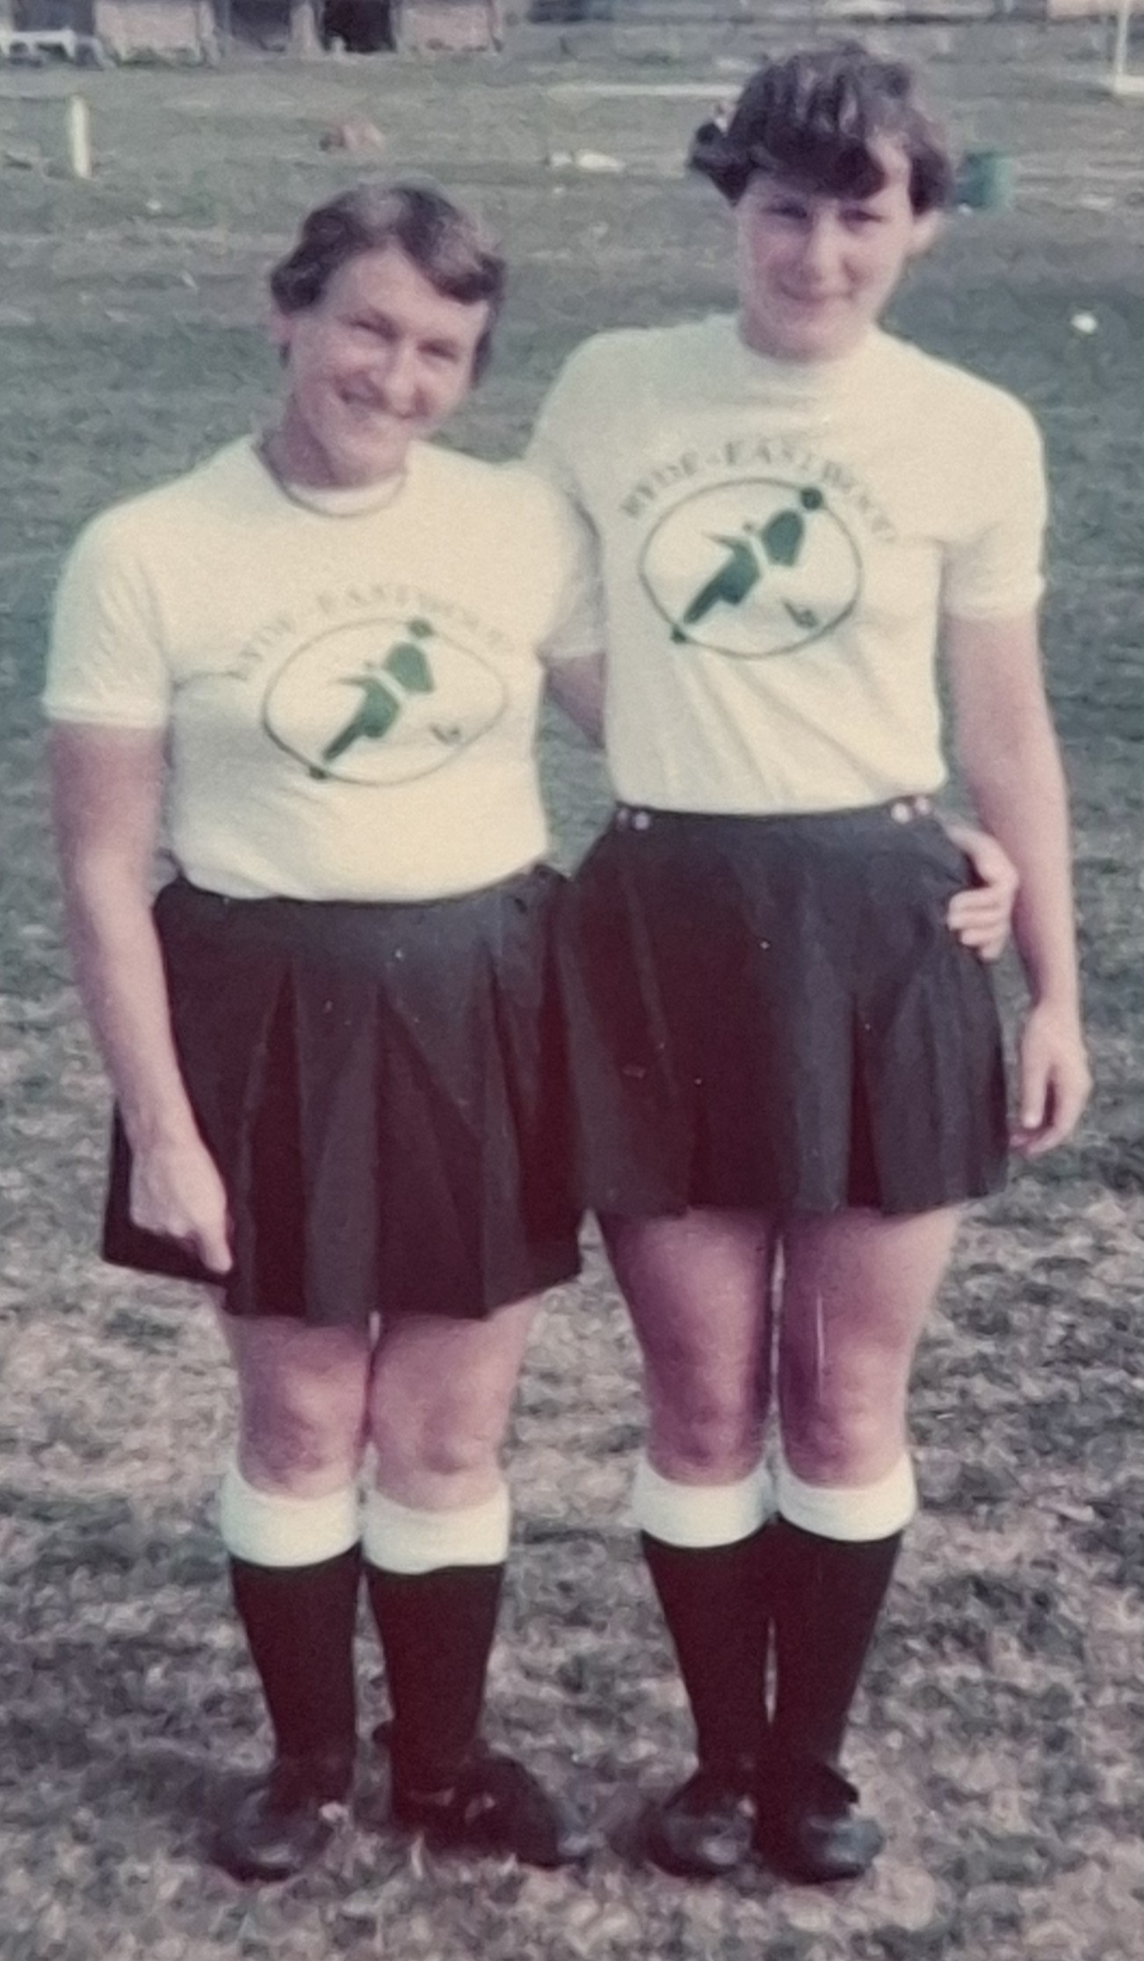
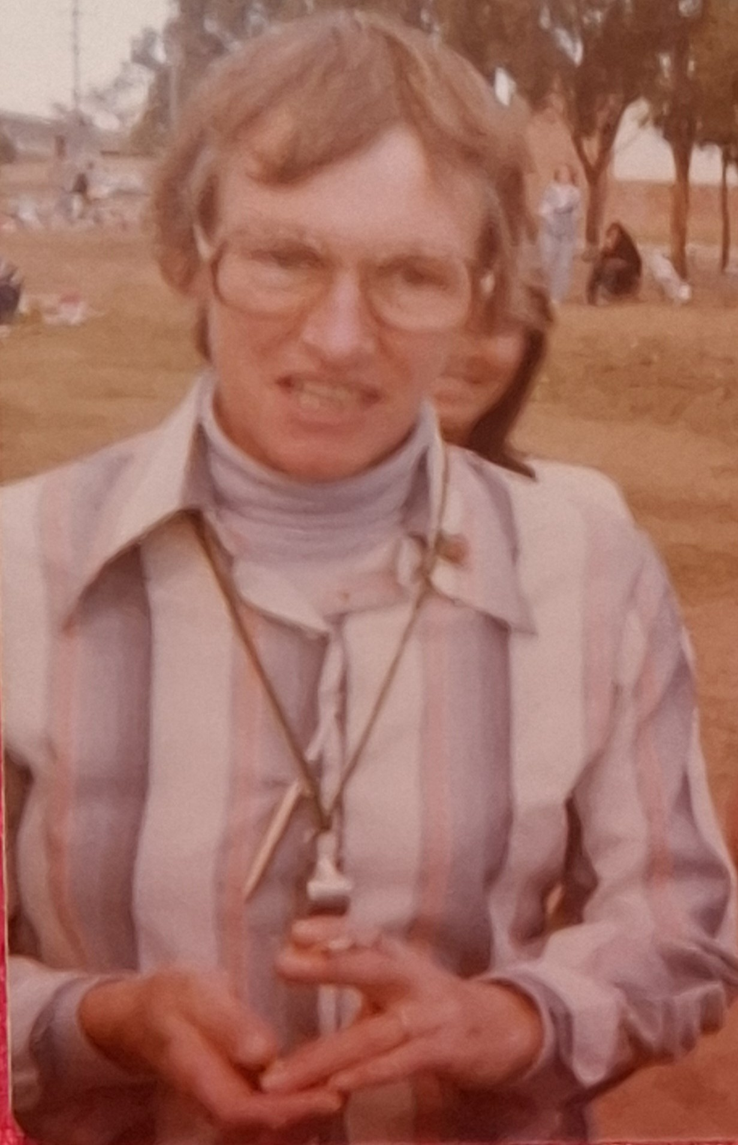
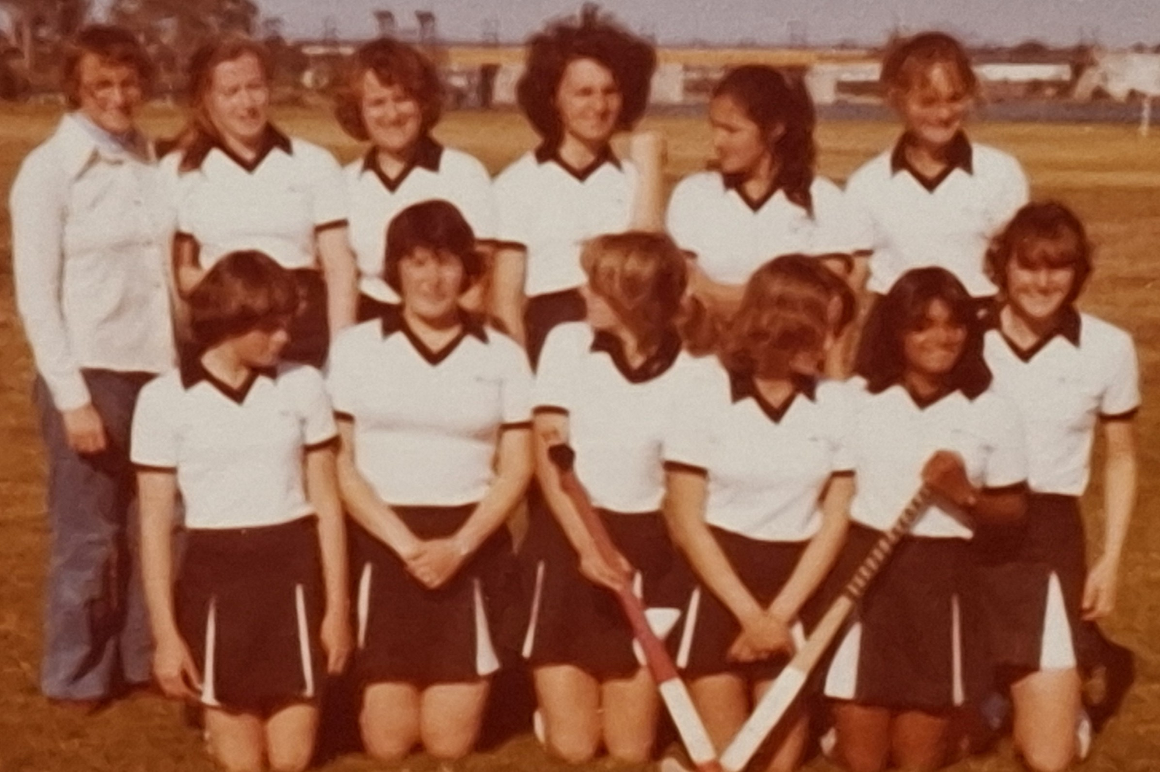
Life Membership
Iris Eagleson

Slide 10

Life Members
D. Chillmaid
K. Clifton
V. Dang
I. Eagleson
K. Gardner
J. Hailstone
G. McKay
F. Polodorus
J. Punch
J. Robinson
D. Russell
G. Stidwell
P. Stokes
A. Torr

Slide 11
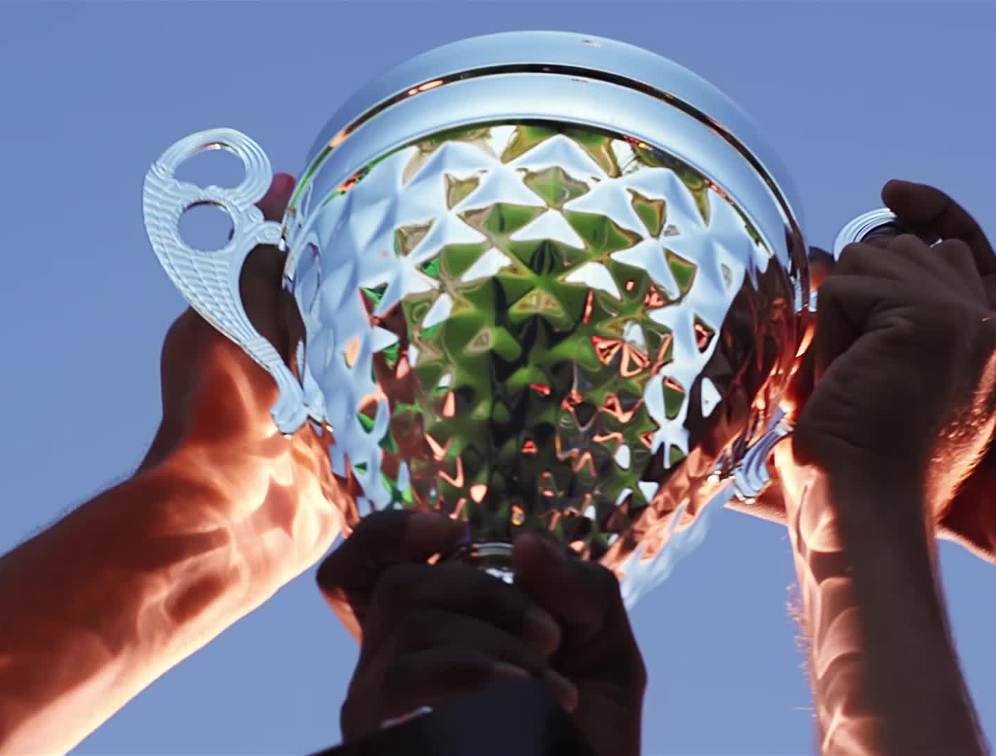
Trophies
  Most Goals Scored
  Best and Fairest
  Guts and Determination
  Most Improved

Slide 12
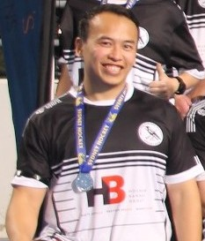
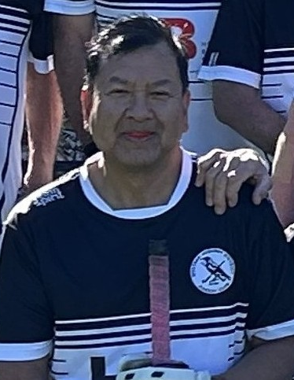
Iris Eagleson memorial trophy for highest goal scorer
  SL5 -
  Michael Tran
  SL7 -
  Vu Dang

Slide 13
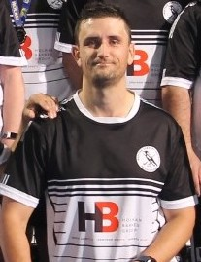
Frank Polidoros Memorial Trophy for Best and Fairest
  SL5 -
  Terrance Bowden
  SL7 -
  Vu Dang

Slide 14
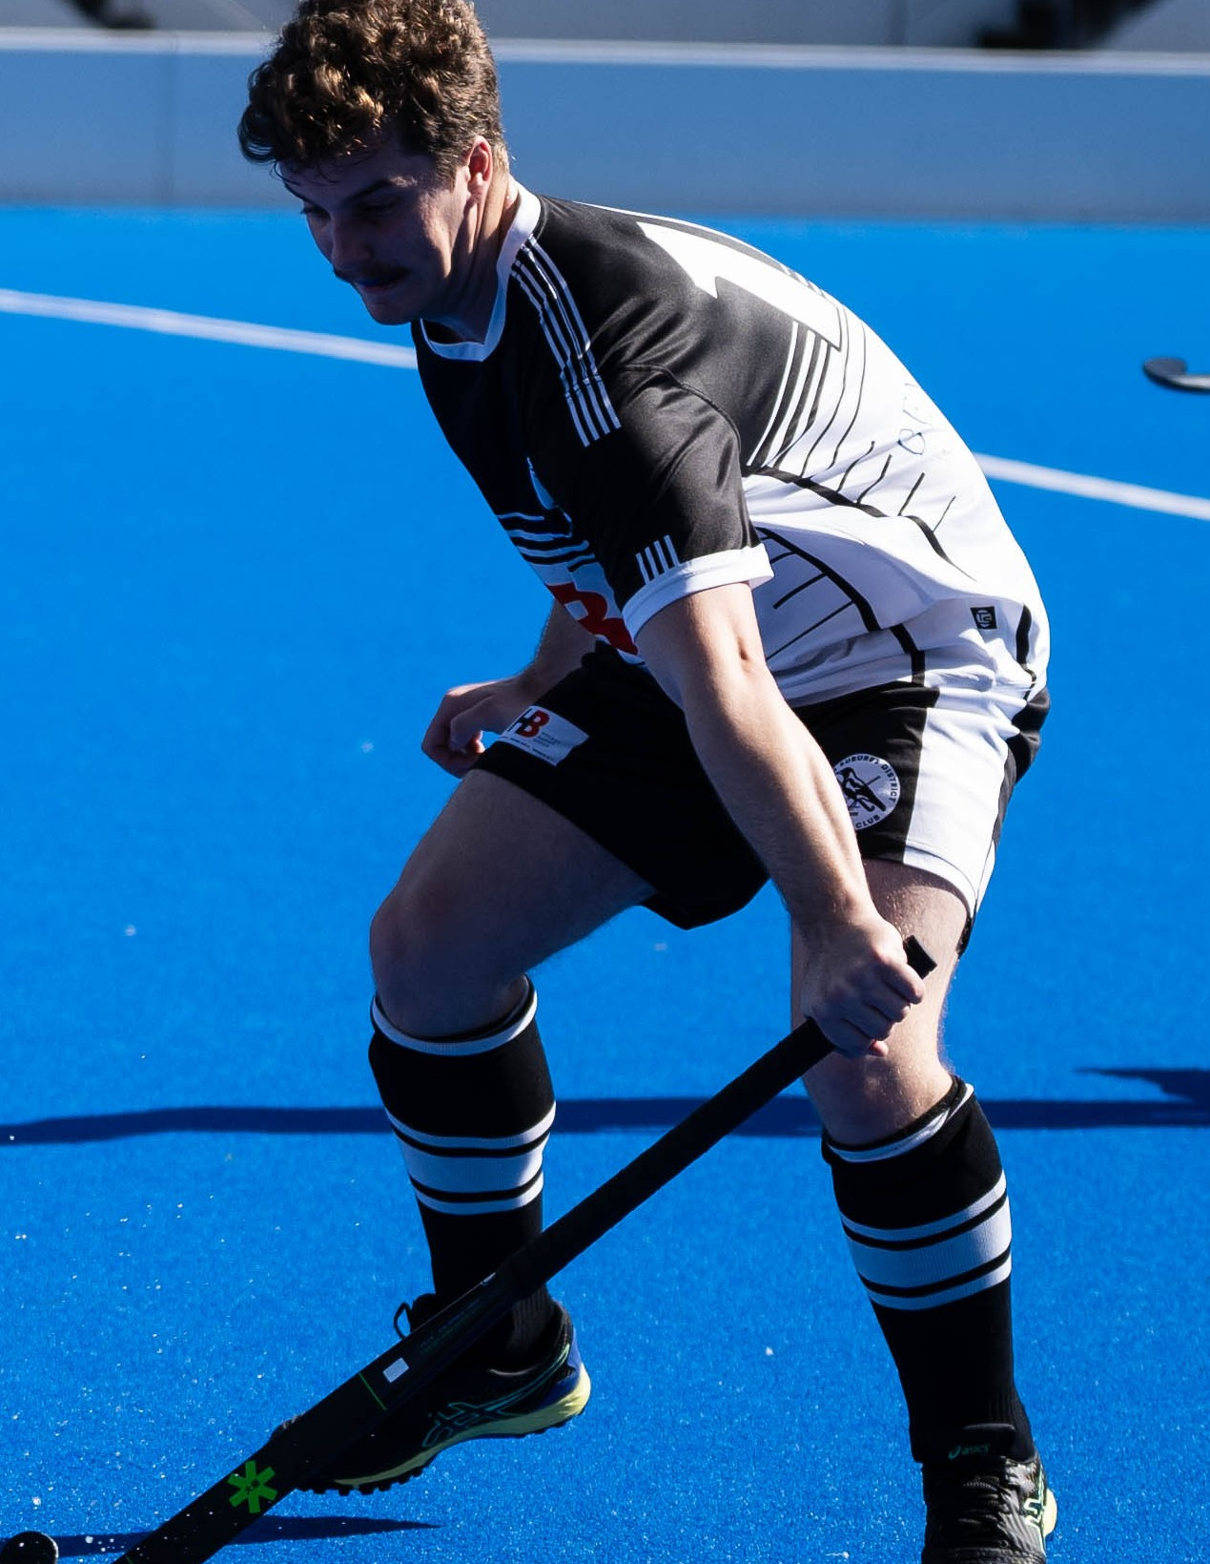
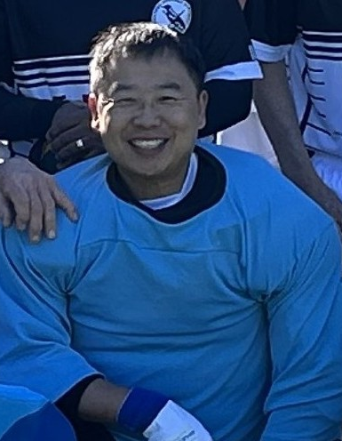
John Punch Memorial Trophy for Guts and Determination
  SL5 -
  Matthew Frith
  SL7 -
  Peter Yick

Slide 15
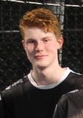
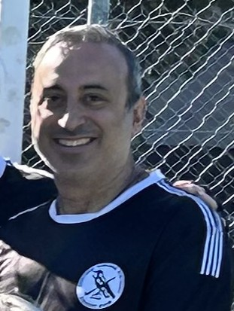
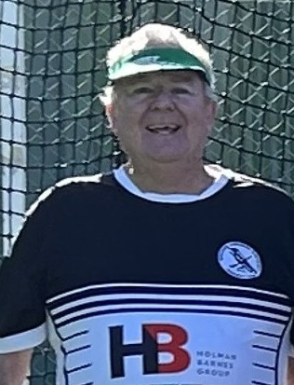
Ken gardner Memorial Trophy for Most Improved
  SL5 -
  SL7 -
  Hamish Batty
  Nicolas E-Debs and Les Simpon

Slide 16
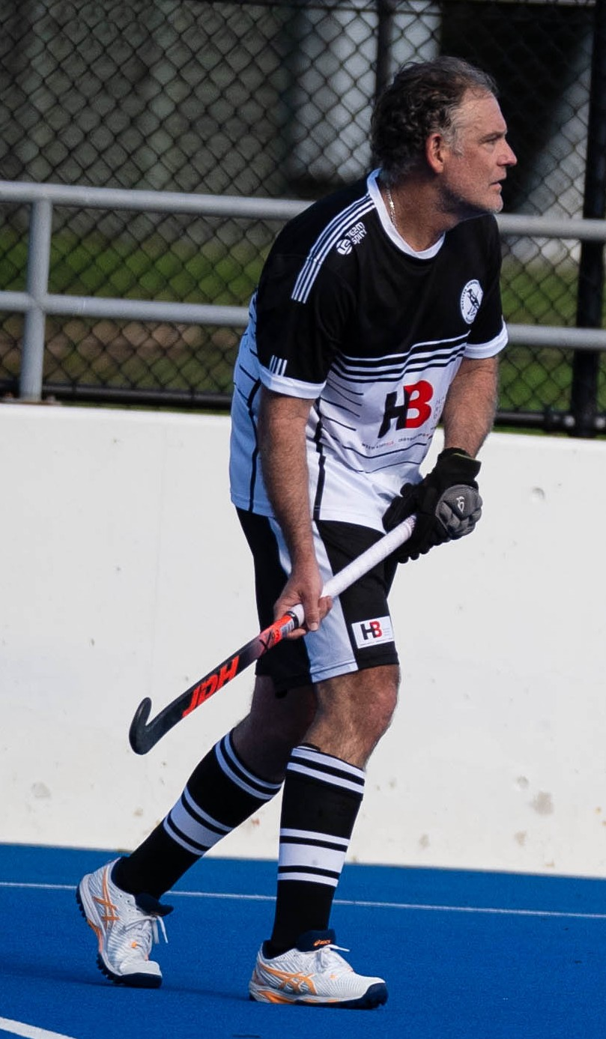
CAPTAIN’s Award
Captain SL5: Michael Tran
Jacob Beatty
Jacob’s leadership, determination, and spirit lifted the entire team throughout the season. He has lead by example through encouragement. he’s shown what it means to lead with heart and purpose.

Slide 17
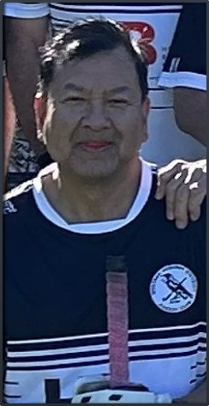
CAPTAIN’s Award
Captain SL5: Phil Bee
Vu Dang
Ever dependable, never gives up. Always reliable in defense and this year in attack.

Slide 18
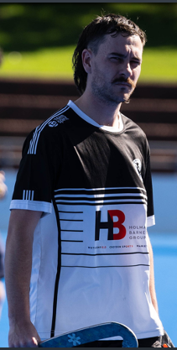
Managers Award
Mary Hennessy
Red Card Award
Dylan McCook

Slide 19

President’s Awards
Ric Byrnes

Slide 20
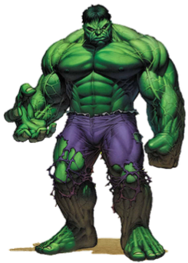
Mr Angry

Slide 21
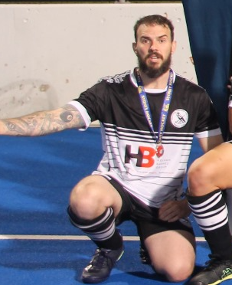
Mr Angry
Grant Bentley
What Me? Why??
For getting yellow carded – should have been red! in the first game of the season!

Slide 22
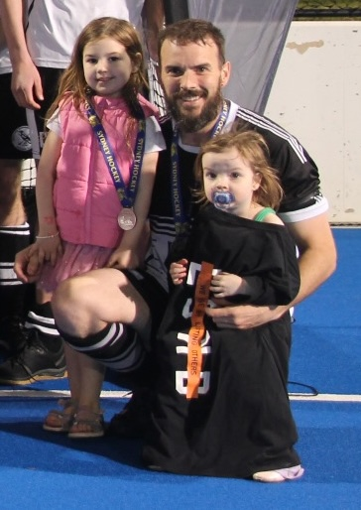
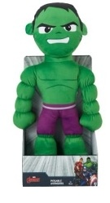
Mr Angry
Winner - Grant Bentley
Awarded Hulk Plushy!
Ok My Girls are with me, now I’m Calm!

Slide 23
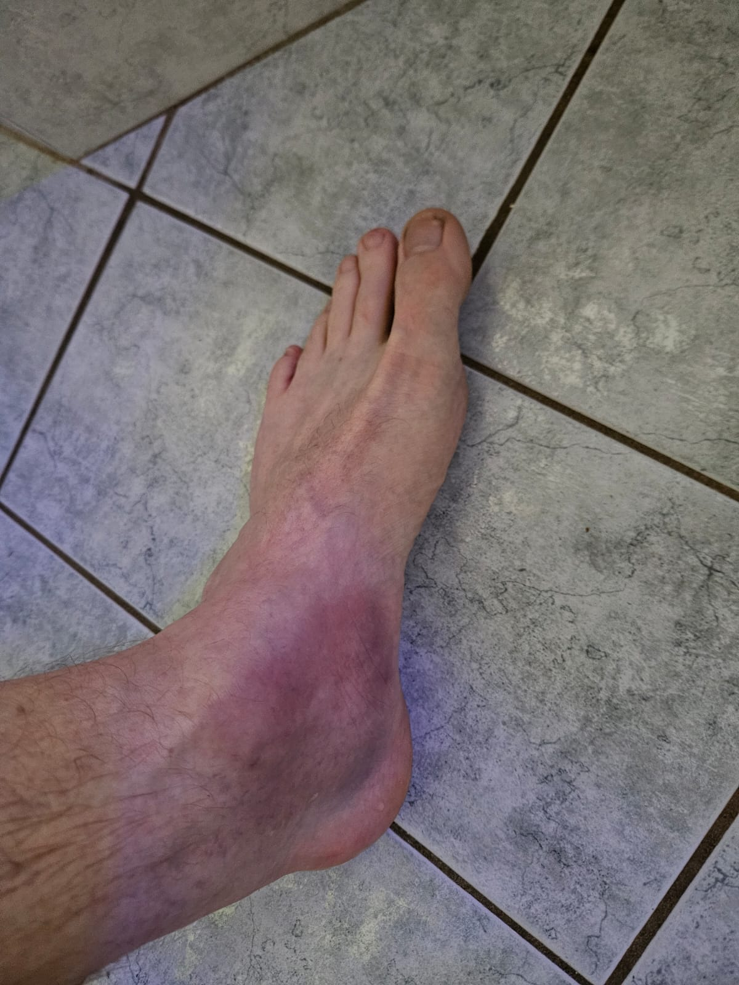
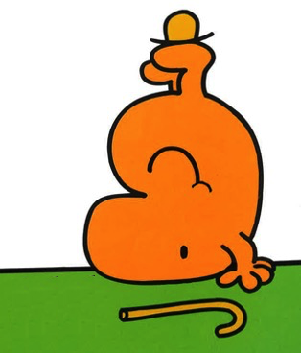
Self Nomination ‘Nothing says Welcome back to hockey more than this!’
Mr Clumsy Topsy Turvy
Nominee - Sean Russell
(Current Award Holder)

Slide 24
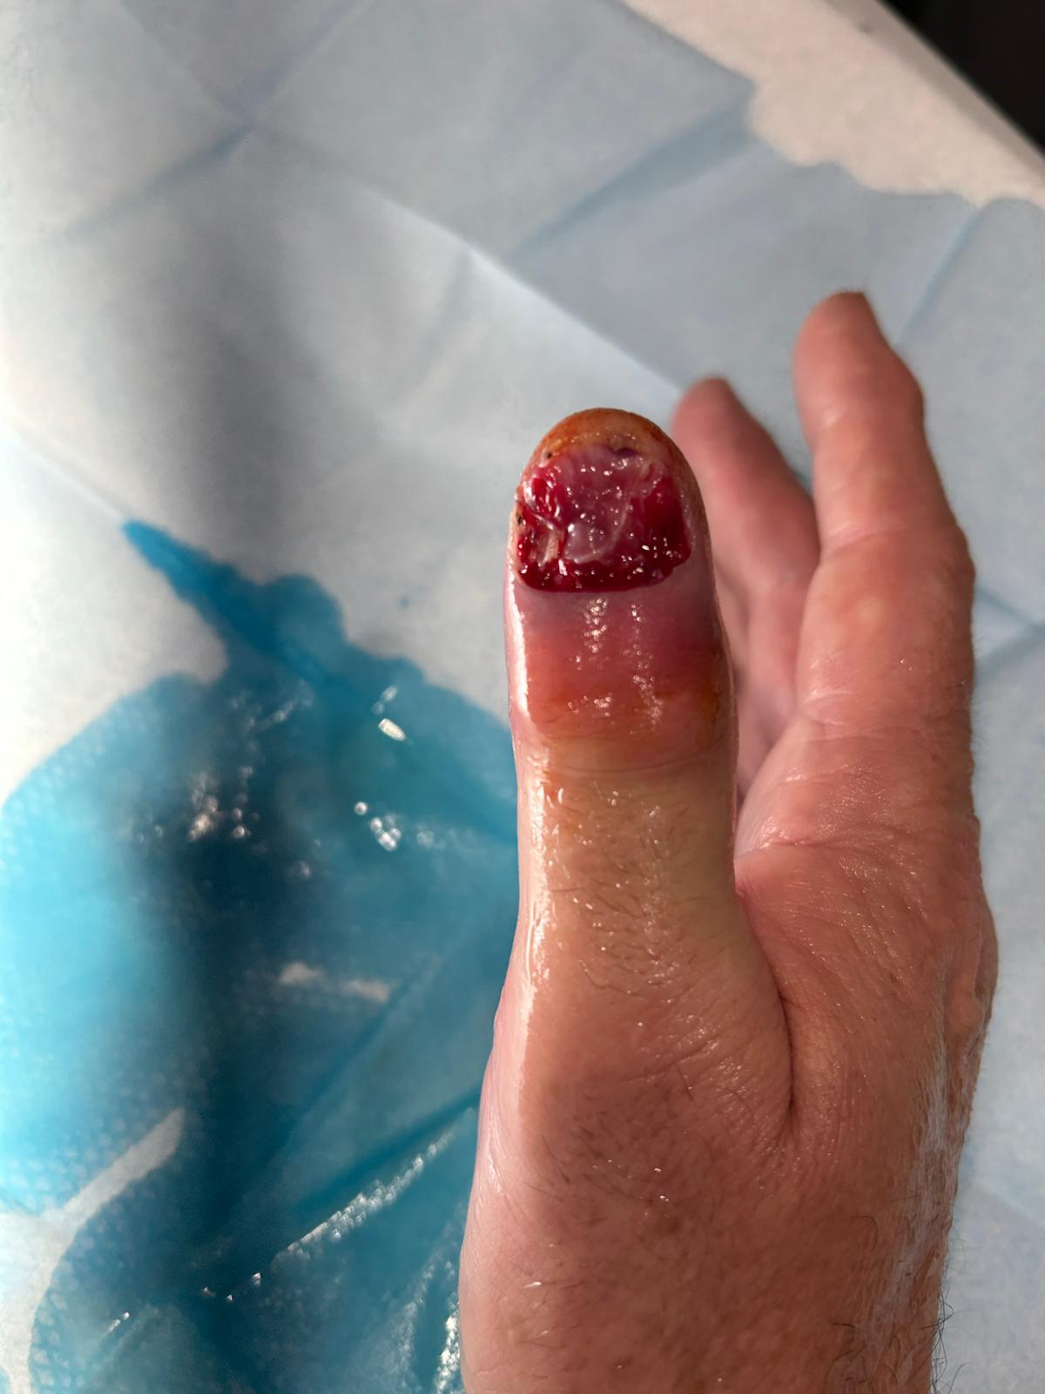

Self Nomination/infliction. Getting a thumb infection right before the finals!
Mr Clumsy Bump
Nominee - Mark Bruhn

Slide 25
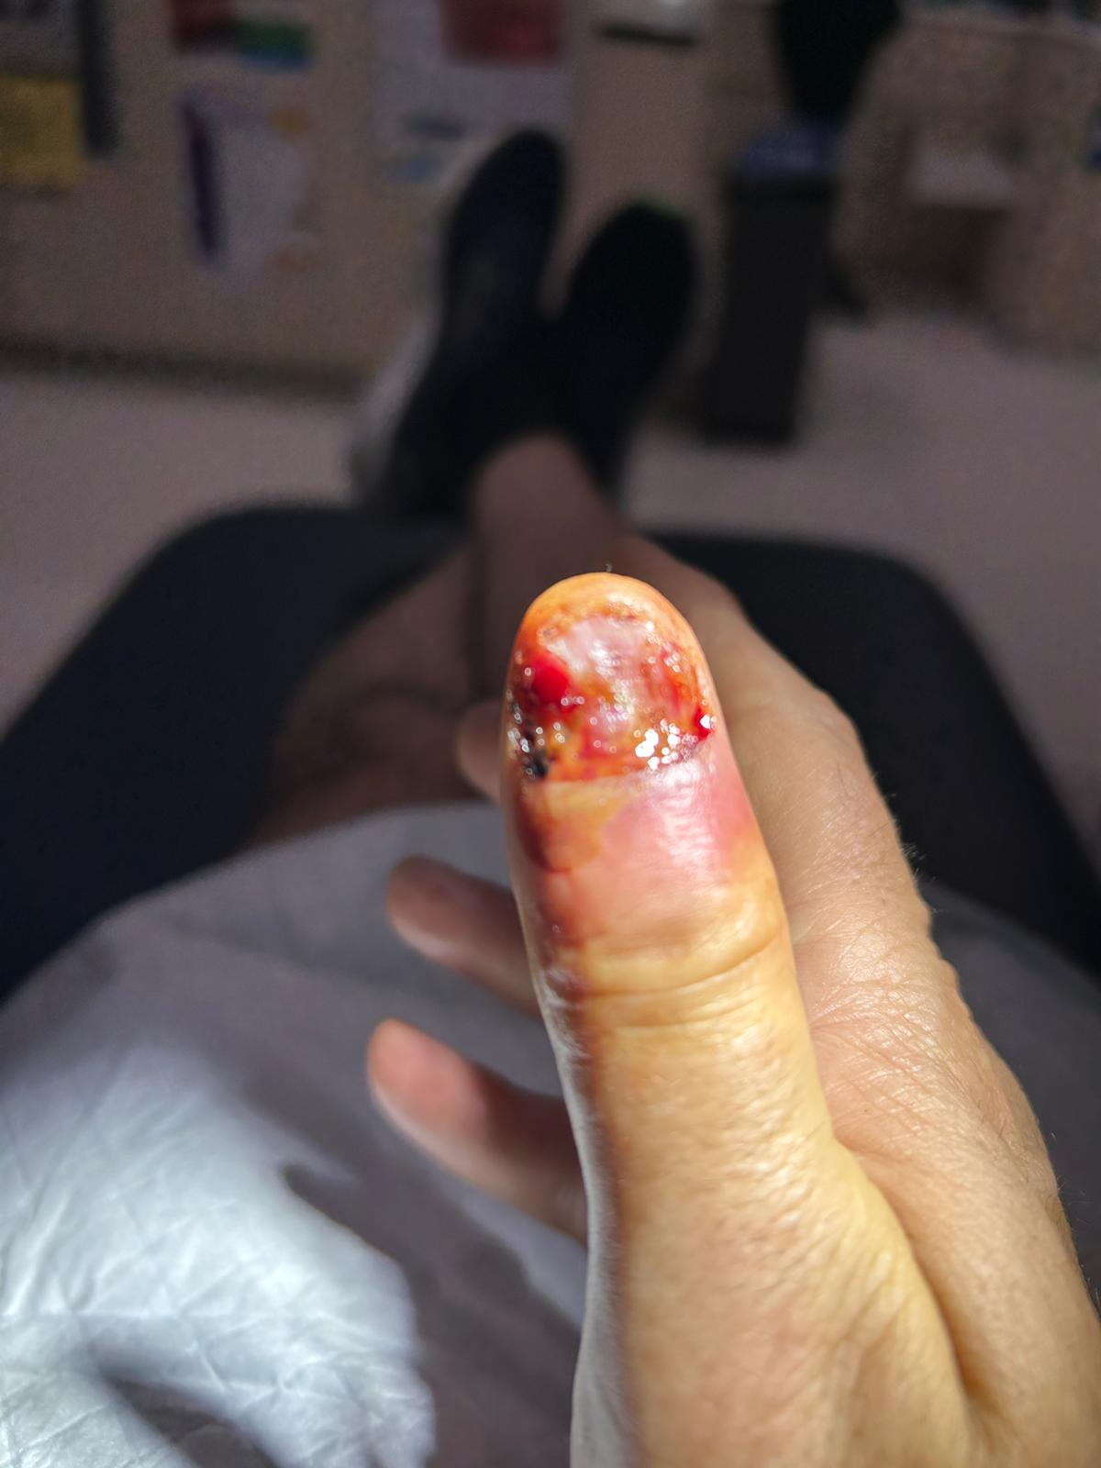
Mr Clumsy Bump
Nominee - Mark Bruhn
Thumb healing… Was this just Mark taking full advantage of Medicare now he’s an Australian Citizen??

Slide 26

Mr Clumsy Topsy Turvy, Bump Dizzy
‘Unless there’s an ambulance called…’

Slide 27
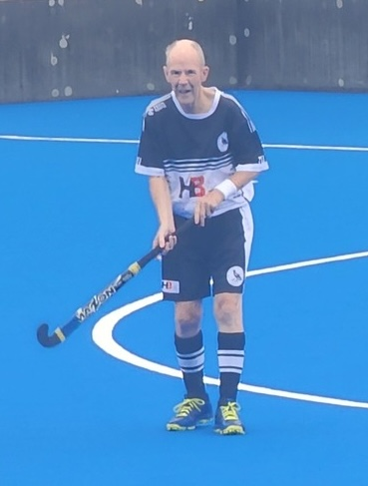
Mr Clumsy Topsy Turvy, Bump Dizzy
Winner - Mike Cook
‘Unless there’s an ambulance called…’

Slide 28
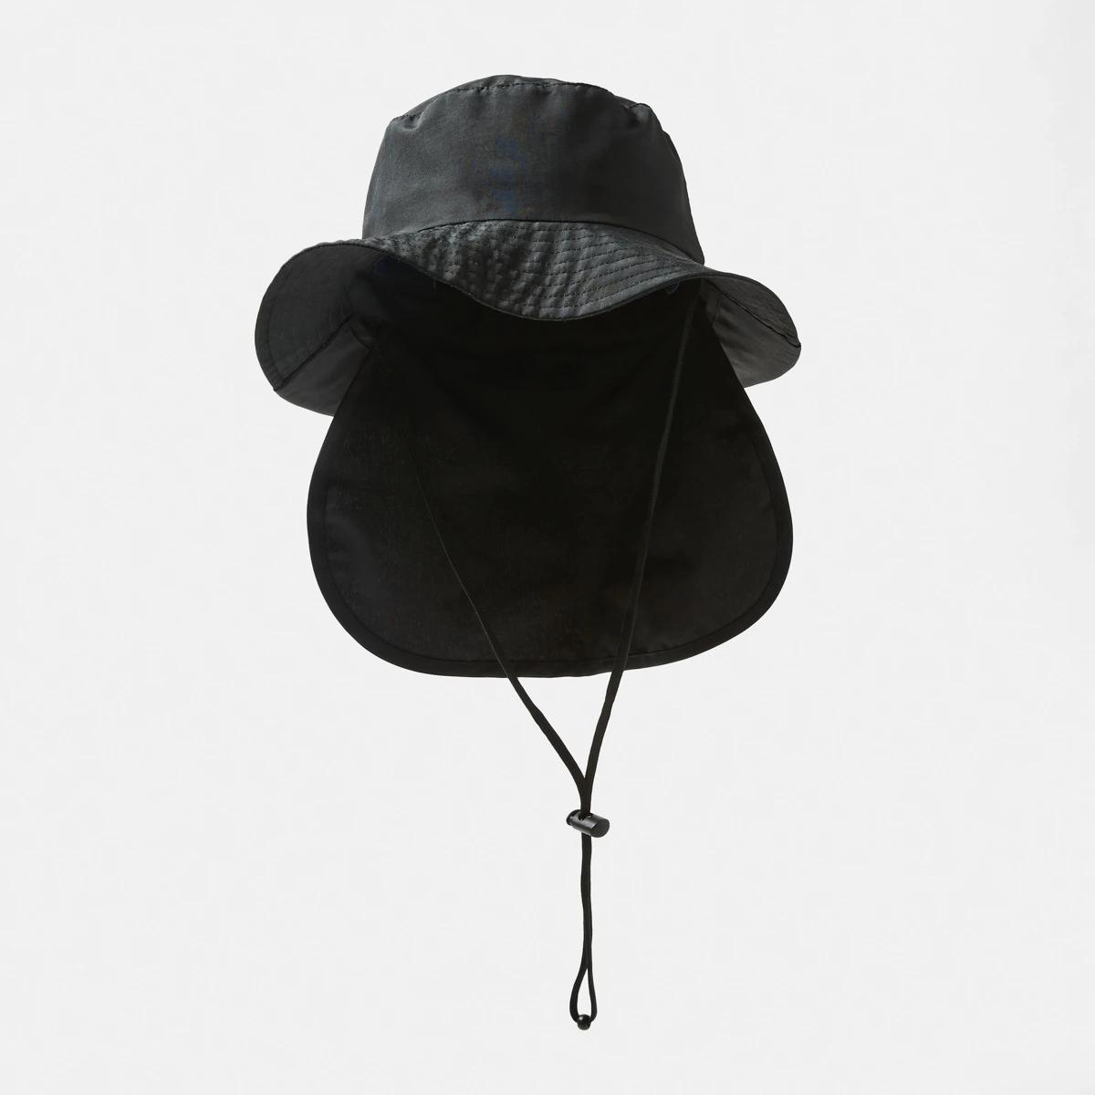
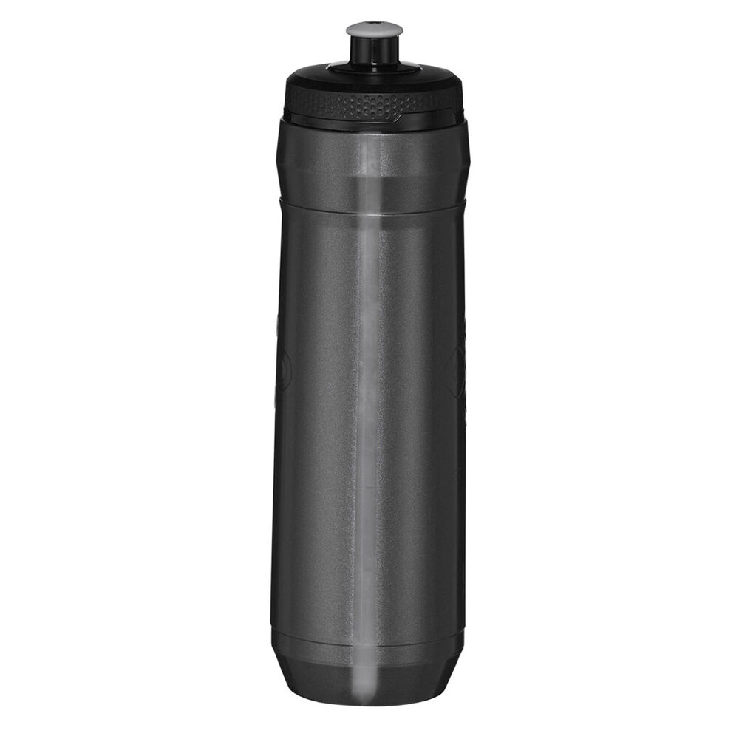
I wish all games were played in the rain like this one! – The first game back after having a Seizure due to heat stroke during a game
Mr Clumsy Topsy Turvy, Bump Dizzy
Winner - Mike Cook
Awarded A Hat with Brim and neck protection. And a water bottle to stay hydrated!

Slide 29
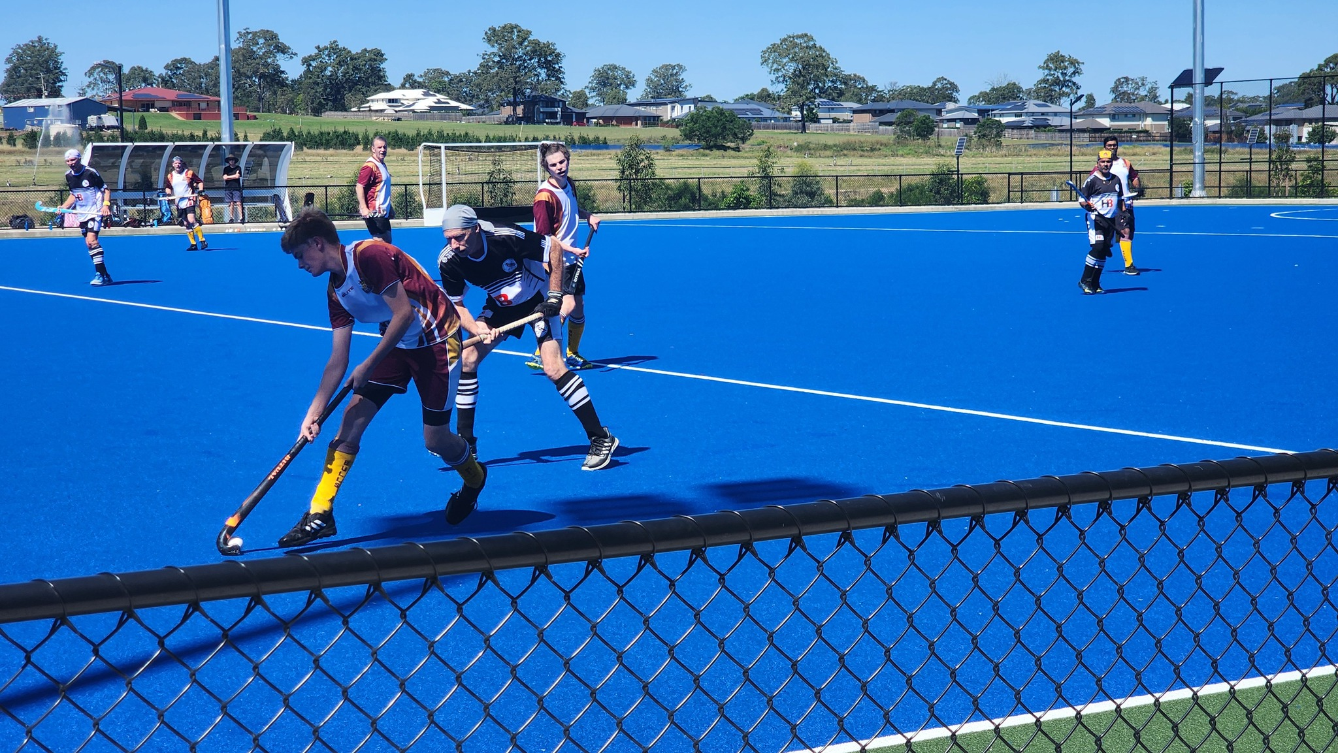
Best Bandana
Nominees
Brian Jones
Jeff Humphreys
Ashley Wainwright??

Slide 30
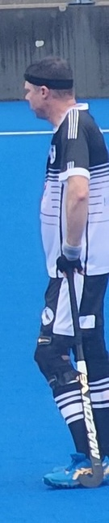
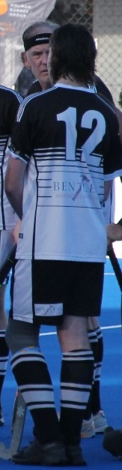
Best Bandana
Nominees
Brian Jones
Jeff Humphreys
Ashley Wainwright??
Special Head band mentions:
Matt Smith
Jacob Beatty

Slide 31
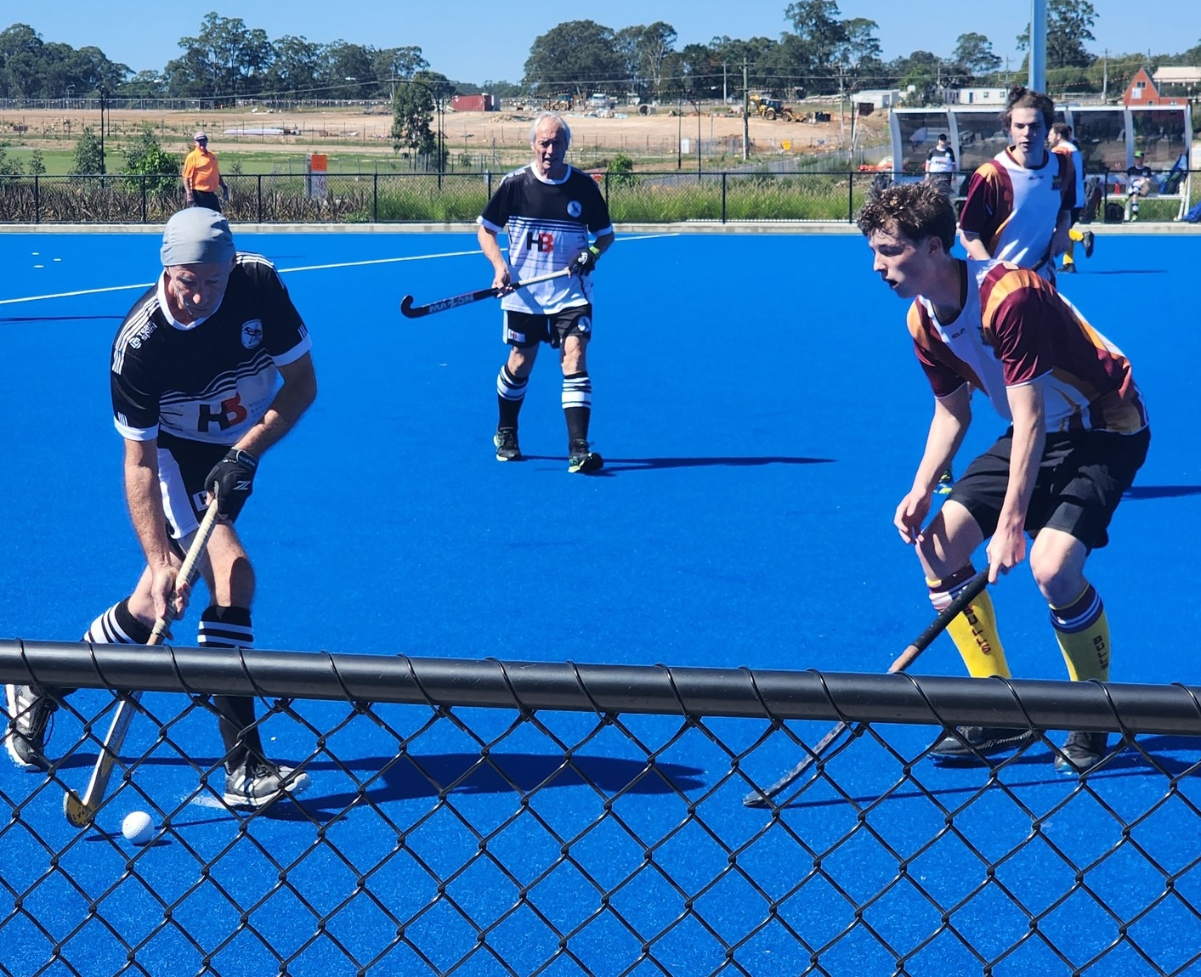
Best Bandana
Winner - Brian Jones
Nominees
Brian Jones
Jeff Humphreys
Ashley Wainwright??
Special Head band mentions:
Matt Smith
Jacob Beatty
For getting as close to the camera as possible from inside the field of play!

Slide 32
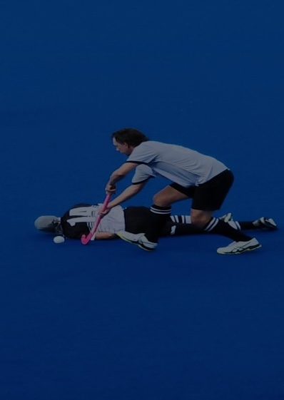
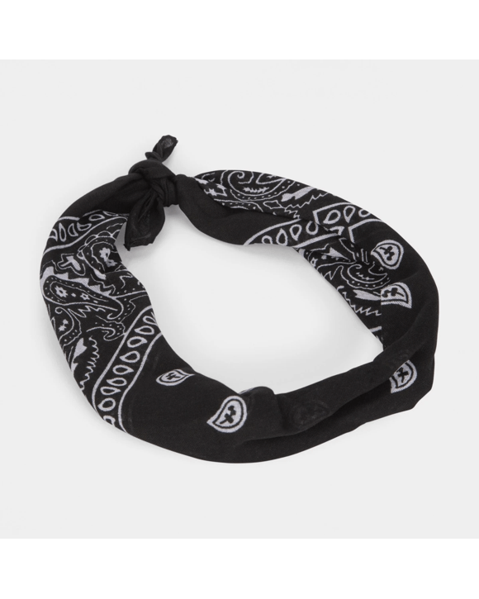
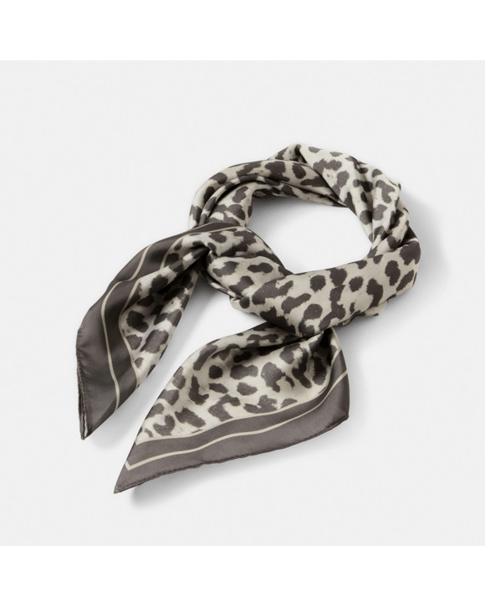
Best Bandana
Winner - Brian Jones
Awarded Black and white Game Bandanas and a silk Bandana for Brian and his evenings…
Other Teams showing their Envy! - I told you we don’t like Bandanas!

Slide 33
Additional Awards

Slide 34
Special thanks
  Mary Hennessy
    Club Secretary
    SL5 and SL7 Manager
  SL 5
    Joshua Newell - Committee Member, Media Publisher
    Yvie Dunn - Coach
    Alice Newell and Archie Bowden – Photographers
  SL 7
    James Mills-Hicks - Committee Member, Media Publisher
    Audra Barclay – Photographer
  Umpires​
    James Tunstall
    Darius Pratt, and
    Les Simpson
As a thank you, Mary and Audra received Champagne. Josh, Yvie, Alice and Archie, received Gift Cards. James a Thumb Drive – He always runs out of space! And Les got a Drink Bottle so he’s well lubricated to give out those cards!

Slide 35


Thank You

